Slide 1
Control Logic
Morris Mano Chapter 10

Slide 2
Introduction
Think of any algorithm (keep it simple, the basic stuff)
Now implement that in hardware
Not so simple, is it?
This is where control logic comes in.

Slide 3
Designing hardware using control logic
- Write the algorithm
- Form a flowchart from the algorithm
- Form a state diagram from the flowchart
- Choose one of the four methods of control organization
- Generate control signals accordingly

Slide 4
Methods of control organization
- One Flip-flop per state method
- Sequence Register and Decoder Method
- PLA control
- Microprogram control

Slide 5
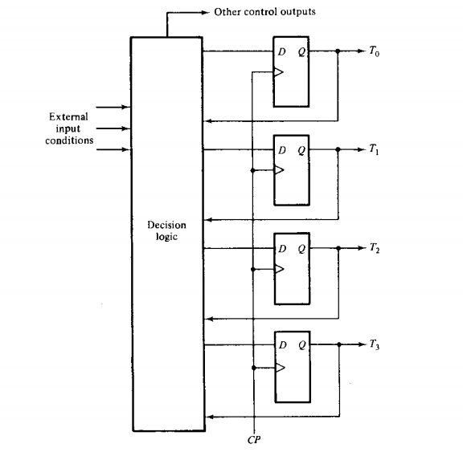
One FF per state
- Recall that we form a state diagram from the flowchart of an algorithm.
- We can treat each state as a flip-flop
- So will have the same number of flip-flops as the number of states.
E.g. if we have 10 states, we will have 10 flip-flops
- At a time, only one flip-flop (meaning one state) will be active.
- Using the active flip-flop, we will generate control signals according the requirement of the state

Slide 6
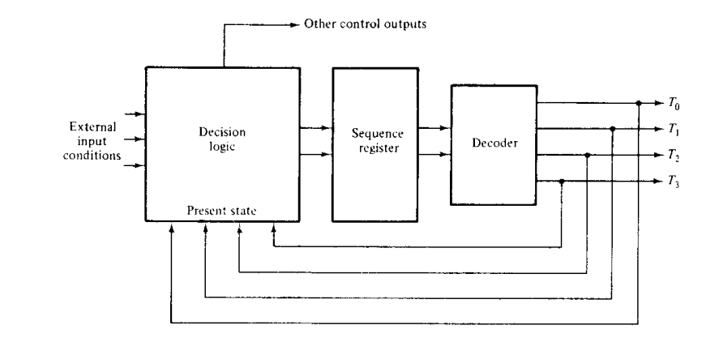

Sequencer Decoder Method
- Minimize the number of FFs.
- For n states, we can use $\left\lceil \log_{2}{n}\right\rceil$ FFs. So for 16 states, we need only 4 FFs.

Slide 7
Addition-Subtraction

Slide 8
Problem Statement
- Implement the hardware for addition/subtraction of two fixed point binary numbers represented in sign-magnitude form
- What is the Sign-magnitude form?
- We have 1 bit to represent the sign of the number. But we don’t store the other bits in 2’s complement form. Rather, we keep the magnitude as it is.
- For example, if we have 4 bit numbers (1 sign bit + 3 bit magnitude) –
3 = 0 011
-3 = 1 011

Slide 9
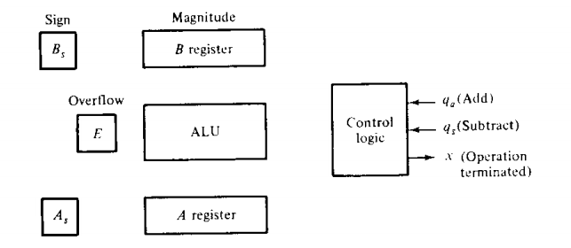
Equipment Configuration

Slide 10
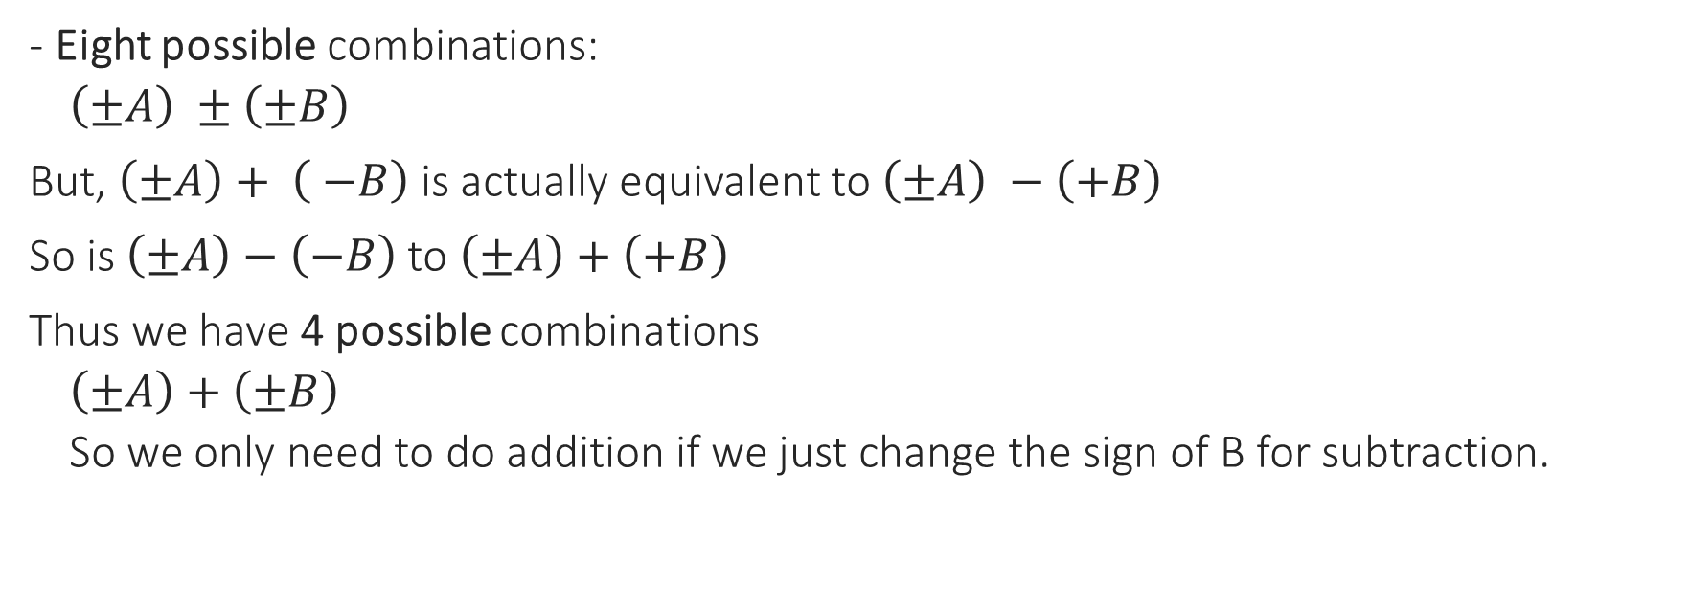
Derivation of the algorithm
- Eight possible combinations:
$\left(±A\right) ±\left(±B\right)$
But, $\left(±A\right)+ \left( −B\right)$is actually equivalent to $\left(±A\right) −\left(+B\right)$
So is $\left(±A\right)−\left(−B\right)$ to $\left(±A\right)+\left(+B\right)$
Thus we have 4 possible combinations
$\left(±A\right)+\left(±B\right)$
So we only need to do addition if we just change the sign of B for subtraction.

Slide 11
Derivation of algorithm
if A ≥ B (C_{out} = 1) if A < B(C_{out} = 0)
(+A) + (+B) = + (A+B)
(+A) + (-B) = +(A-B) - (B-A)
(- A) + (+B) = - (A-B) +(B-A)
(- A) + (-B) = - (A+B)

Slide 12
Algorithm
If subtraction, complement the sign of B
If the sign of A and B are equal- A = A + B, E = C_{out} , end of process
Else –
A = A – B, E = C_{out}
Check if the result (A) is positive, if so set E = 0 and end
Otherwise change A to –A by performing 2’s complement. Also complement the sign of A, and end process.
Question: We are using sign-magnitude form here. But why did we use 2’s complement to change A to –A?

Slide 13
Flowchart
Initial State x=1
T0
qa=1
qs=1
Bs=Bs’
T1
T2
As:Bs
!=
=
A=A+B’+1
E=Cout
T4
A=A+B
E=Cout
T3
E
T5
0(A<B)
1 (A>=B)
A=A’
T6
E=0
A=A+1
As=As’
T7

Slide 14
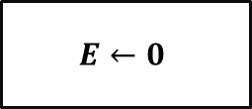
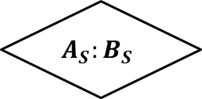
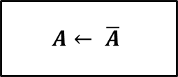
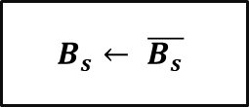


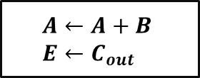

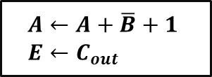
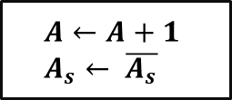
Initial State x = 1
q_{s} = 1
q_{a} = 1
$$B_{s}← \overline{B_{s}}$$
≠
$$A_{S}:B_{S}$$
=
$$A←A+\overline{B}+1 \\ E←C_{out}$$
$$A←A+B \\ E←C_{out}$$
= 0 $(A<B)$
$$E$$
= 1 $(A≥B)$
$$A← \overline{A}$$
$$E←0$$
$$A←A+1 \\ A_{s}← \overline{A_{s}}$$

Slide 15
State Diagram
qs=0
qa=0
T0
qs=1
T1
T3
qa=1
S=0
T2
E=1
S=1
T7
T4
T6
T5
E=0

Slide 16
Control Signals
 | X | S2 | S1 | S0 | Cin | L | y | z | w
T0:Ininitial state x=1 | 1 | 0 | 0 | 0 | 0 | 0 | 0 | 0 | 0
T1: B_{s} = B_{s}’ | 0 | 0 | 0 | 0 | 0 | 0 | 1 | 0 | 0
T2: nothing | 0 | 0 | 0 | 0 | 0 | 0 | 0 | 0 | 0
T3: A =A+B E=C_{out} | 0 | 0 | 0 | 1 | 0 | 1 | 0 | 0 | 0
T4: A+B’+1 E=C_{out} | 0 | 0 | 1 | 0 | 1 | 1 | 0 | 0 | 0
T5: E=0 | 0 | 0 | 0 | 0 | 0 | 0 | 0 | 0 | 1
T6: A=A’ | 0 | 1 | 1 | 1 | 0 | 1 | 0 | 0 | 0
T7:A=A+1 A_{s}=A_{s}’ | 0 | 0 | 0 | 0 | 1 | 1 | 0 | 1 | 0

Slide 17
Boolean Functions for control
Flip-flop input functions
DT₀ = q_{a}‘q_{s}’T₀ + T₃ + ET₅ + T₇
DT₁ = q_{s}T₀
DT₂ = q_{a}T₀ + T₁
DT₃ = S’T₂
DT₄ = ST₂
DT₅ = T₄
DT₆ = E’T₅
DT₇ = T₆
Output control functions
x = T₀
s₂ = T₆
s₁ = T₄ + T₆
s₀ = T₃ + T₆
C_{in} = T₄ + T₇
L = T₃ + T₄ + T₆ + T₇
y = T₁
z = T₇
w = T₅

Slide 18
Multiplication

Slide 19
Problem Statement
- Perform multiplication of two fixed point binary numbers in sign-magnitude representation
- Each magnitude is k bits long
- So the product can be up to 2k bits long.

Slide 20
Concept
23 10111 multiplicand
19 x 10011 multiplier
---- --------
10111
10111
00000
00000
10111
--------------
437 110110101 product

Slide 21
Concept (cont.)
- Look at successive bits of the multiplier, LSB first.
- If the multiplier bit is a 1, the multiplicand is copied down, otherwise zeros are copied down.
- The numbers copied down in successive lines are shifted one position to the left.
- Finally numbers are added.
- Sign of product is the XOR of the signs of multiplicand and multiplier.

Slide 22
Concept (cont.)
- Problem of this method?
- We cannot copy down the values anywhere in hardware.
- So we change the process a bit.

Slide 23
Solution
- Provide circuit for the summation of only two binary numbers and successively accumulate the partial products in a register.
- Instead of shifting multiplicand to the left, we shift the partial product to the right.
- When corresponding bit of multiplier is 0, there is no need to add all zeros.

Slide 24
Example
Multiplicand: 1011 Multiplier: 1101 ------------ 1st multiplier bit = 1, add multiplicand 1011 shift right 01011 2nd multiplier bit = 0, shift right 001011 3rd multiplier bit = 1, add multiplicand 110111 shift right 0110111 4th multiplier bit = 1, add multiplicand 10001111 shift right 10001111 (product)

Slide 25
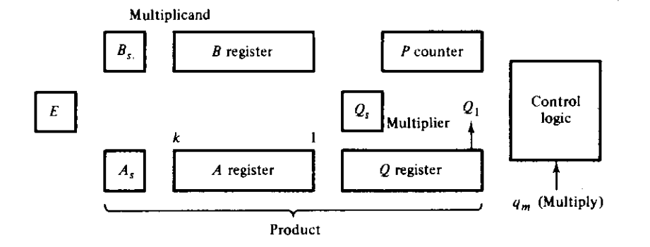
Equipment Configuration

Slide 26
Algorithm
Initial State x=1
T0
q_{m}=1
A_{s}=B_{s} ⊕ Q_{s}
A=0, E=0
P=k
T1
0
Q1
1
Q1T2
T2
A=A+B
E=C_{out}
P=P-1
P=P-1
AQ=shr EAQ, E=0
T3
P
!=0
=0

Slide 27
State Diagram
P_{z}=1
q_{m}=0
T0
T1
T2
T3
q_{m}=1
P_{z}=0

Slide 28
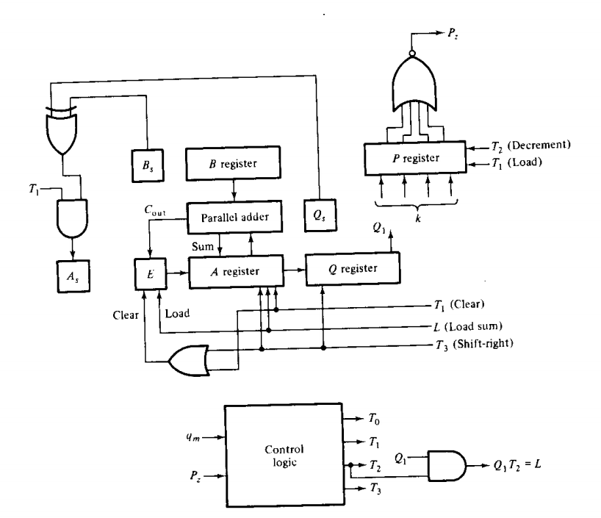
Data Processor

Slide 29
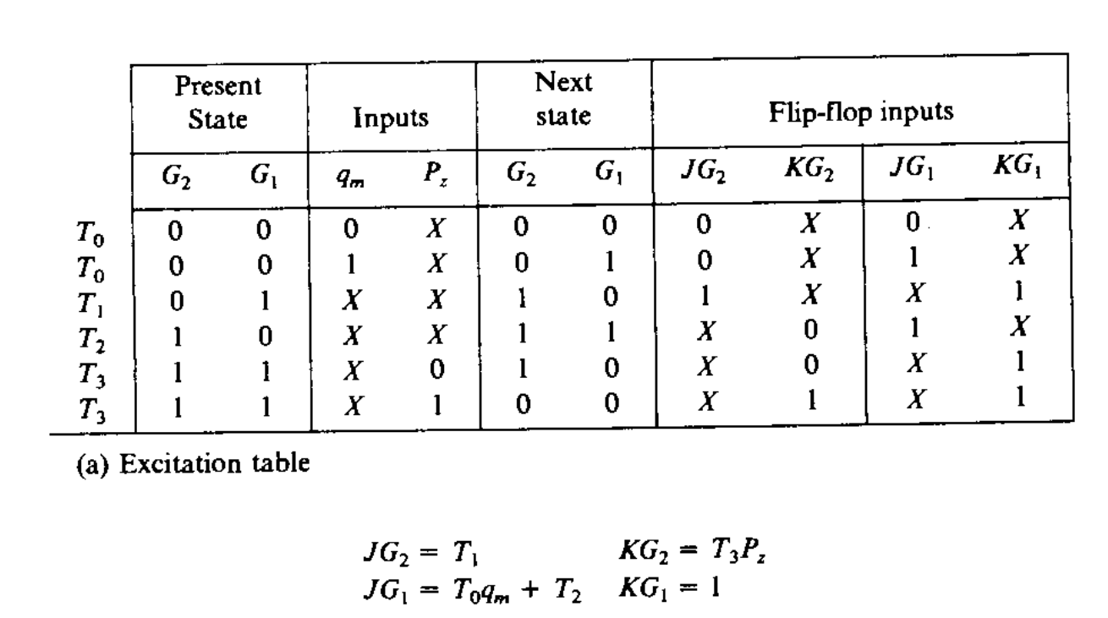
Control Design

Slide 30
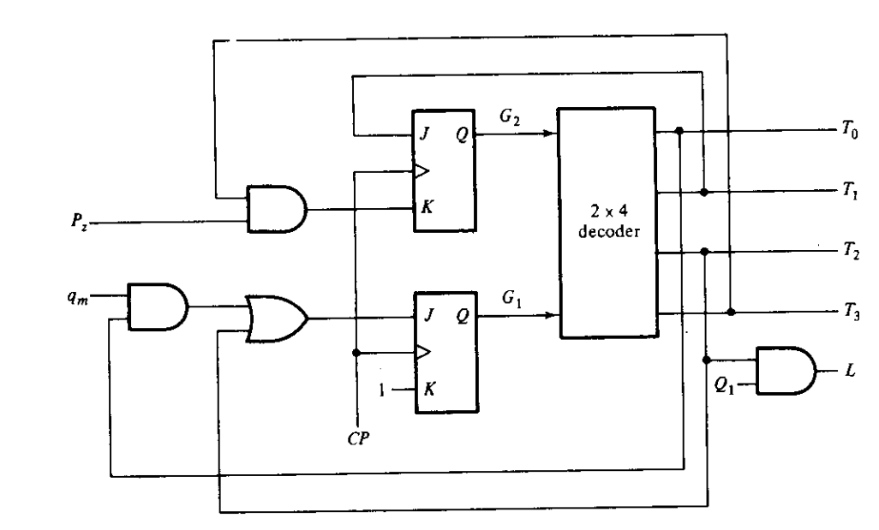
Hardware

Slide 31
Assignment
1. Implement Addition-Subtraction with Sequence Register-Decoder method.
2. Implement Multiplication with One FF per state method.

